Slide 1
Plan, Schedule, Test Community Portal
Module Project
Module: NICF Capstone Project using Java
Course: NICF Advanced Certificate in Software & Applications (Development & Deployment)
Start Date : 27 July 2023
End Date : 18 August 2023
Submission Date : 23 August 2023
Learner Name : Syukur Sidiq Nur Alam
Enrollment ID : BDSE-0922-089
Presentation Date : 24 August 2023

Slide 2
Contents
Document History
Version Number | Effective Date of release | Summary of Included Changes | Author
1 | 4th March 2016 | First Edition | Satya CVS
2 | 23rd Jul 2018 | Changed for Module 6 | Shrinivas K R

Slide 3
Contents
Contents
S. No. | Description
01 | Different Types of Testing
02 | How Different Testing Helps
03 | Tests Selected
04 | Test Schedule
05 | Test Results
06 | Testing Tools
07 | Project Milestone & Tasks
08 | Milestone Feedback & Action Taken
09 | Modifications Made Based on Feedback
10 | Project Results
11 | Proposed Improvements

Slide 4
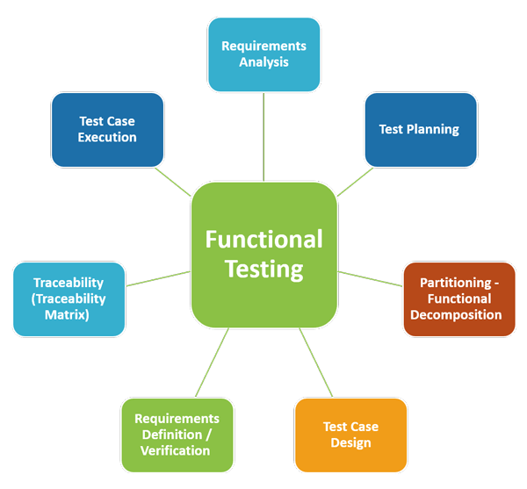
1. Different Types of Testing
List types of Testing
Functional Testing
User Acceptance Testing
Unit Testing
Non Functional Testing
Cross Browser Testing
Load Testing
Usability Testing

Slide 5
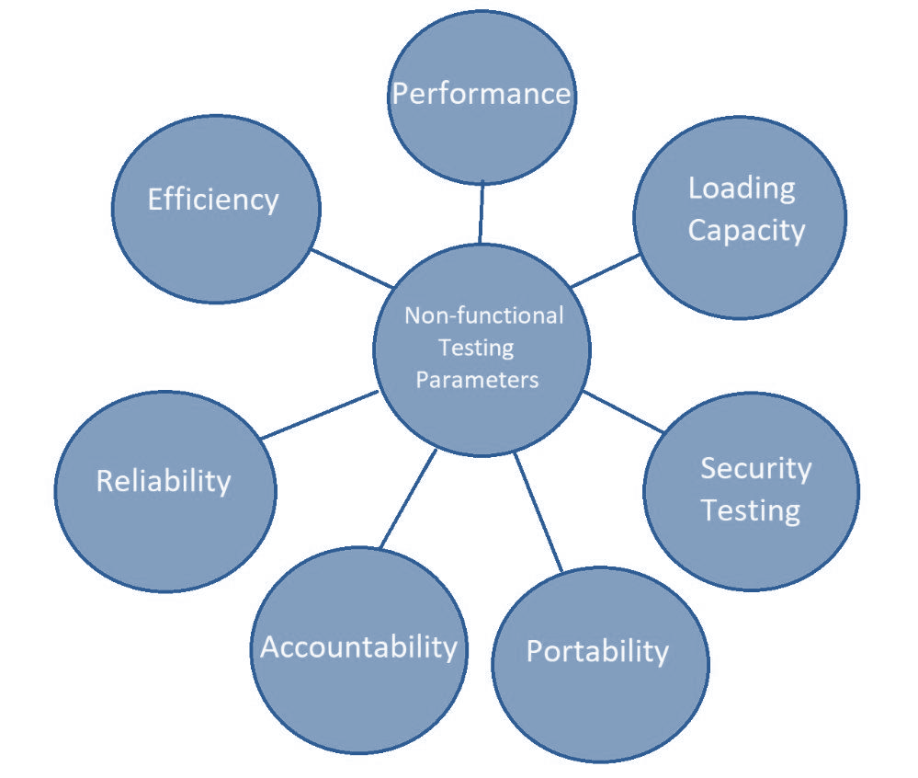
1. Different Types of Testing
List types of Testing
Functional Testing
User Acceptance Testing
Unit Testing
Non Functional Testing
Cross Browser Testing
Load Testing
Usability Testing

Slide 6
2. How Different Test Helps
Functional Testing:
Unit Tests: Unit testing makes ensuring that the community portal's various parts function as intended. Unit tests improve the overall stability of the codebase by spotting and fixing problems at the component level.
User Acceptance Testing (UAT): UAT involves actual users testing the portal from the viewpoint of the end user. By testing usability, functionality, and user experience, UAT makes sure the portal lives up to user expectations.

Slide 7
2. How Different Test Helps
Non-Functional Testing:
1. Cross-Browser Testing: This process verifies that the community portal works correctly in a variety of browsers. This ensures a consistent user experience and optimal functionality for a wider audience utilizing various browser options, improving accessibility and user happiness.
2. Load testing evaluates the performance of the portal under varied user loads. The portal's responsiveness and scalability are ensured by load testing. by determining the maximum number of users. Even during times of high demand, this optimization keeps the user experience stable and streamlined.
3. Usability Testing: Usability testing gauges how user-friendly and simple-to-use the portal is. Tasks are completed by real users to find areas of difficulty or confusion. By enhancing the user interface and navigation, this testing increases user happiness and the overall user experience.

Slide 8
3. Tests Selected
Test Scenario ID | Test Scenario | Number of test cases
TS001-Unit Testing | Test each component in the application | 4
TS002- UAT testing | Ensure the portal’s features align with course requirements and meet users’ expectations. | 2
TS003-Cross Browser testing | Ensure the application works across multiple major browsers | 4
TS004- Load Testing | Testing the performance of the application | 2
TS005 – Usability Testing | To ensure all navigation in header and footer works properly and the content is visible | 2

Slide 9
4. Test Schedule
Web page | Weighting | Functional Points (FP) | Total
Apply for Job | 3 | 5 | 15
Post Job | 3 | 5 | 15
Thread | 3 | 5 | 15
 |  | Total functional points | 45
 |  | Estimated person hour per FP | 1.0
 |  | Total hours needed | 45
 |  | Total days needed | 8.5 days

Slide 10
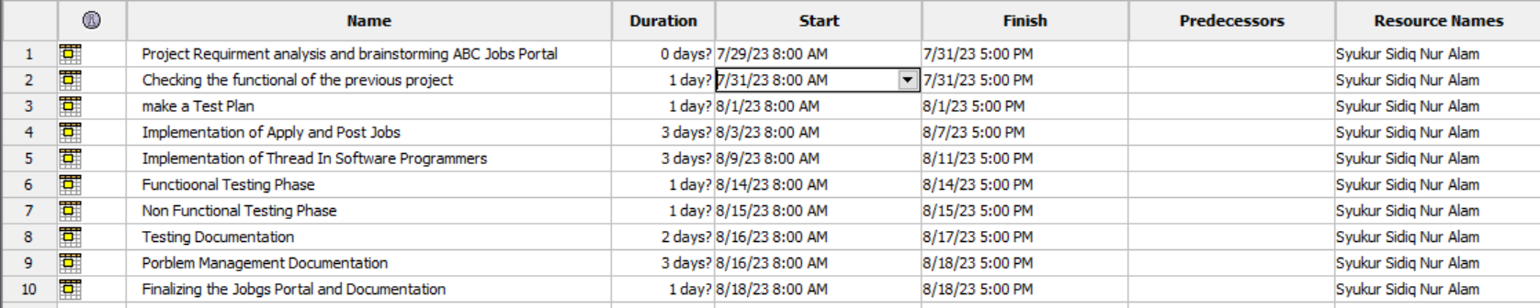
4. Test Schedule

Slide 11
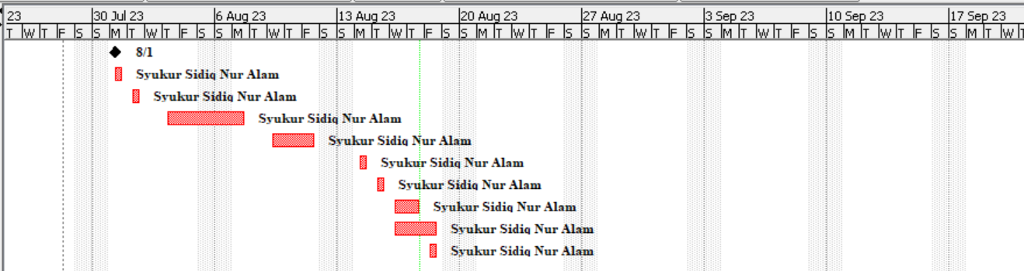
4. Test Schedule

Slide 12
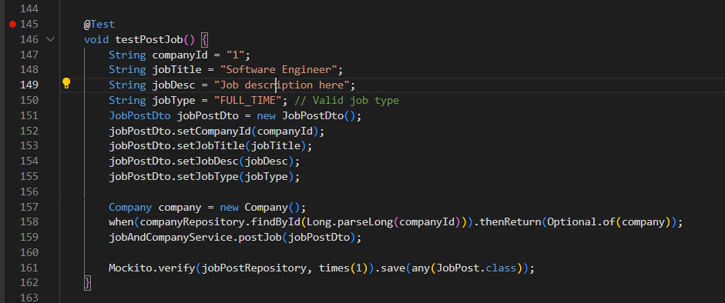
5. Test Results
Unit Testing

Slide 13
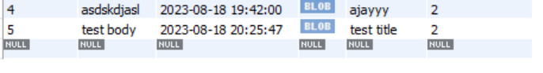
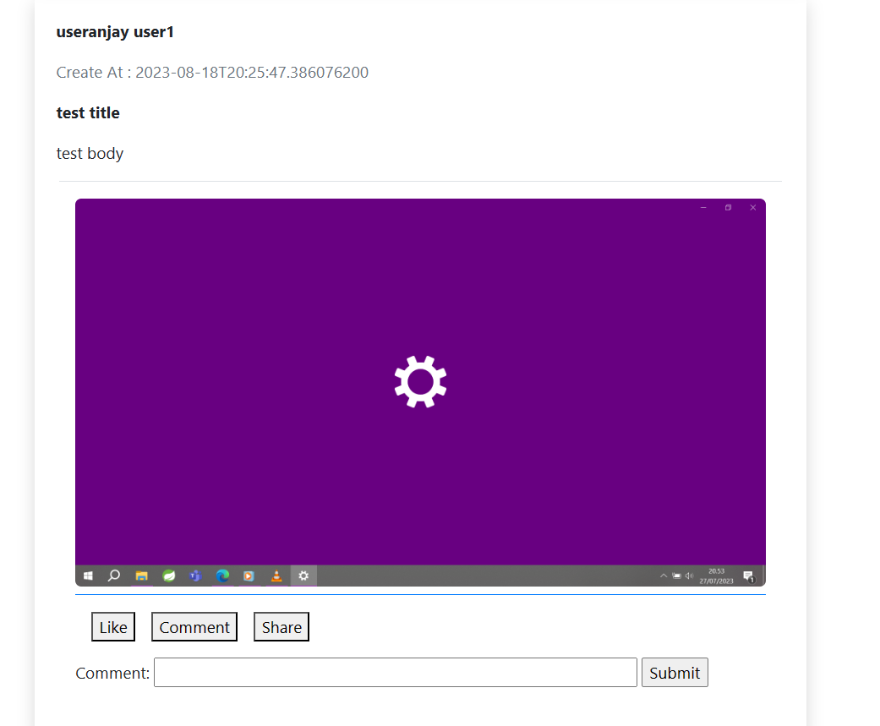
5. Test Results
UAT Testing

Slide 14
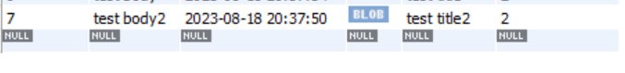
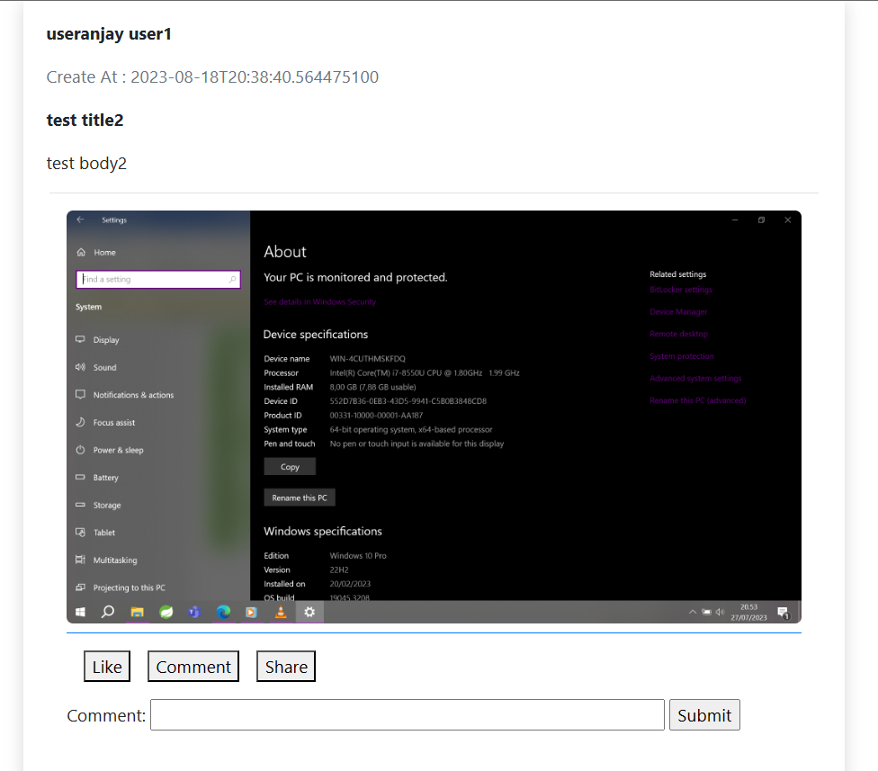
5. Test Results
Cross Browser Testing

Slide 15
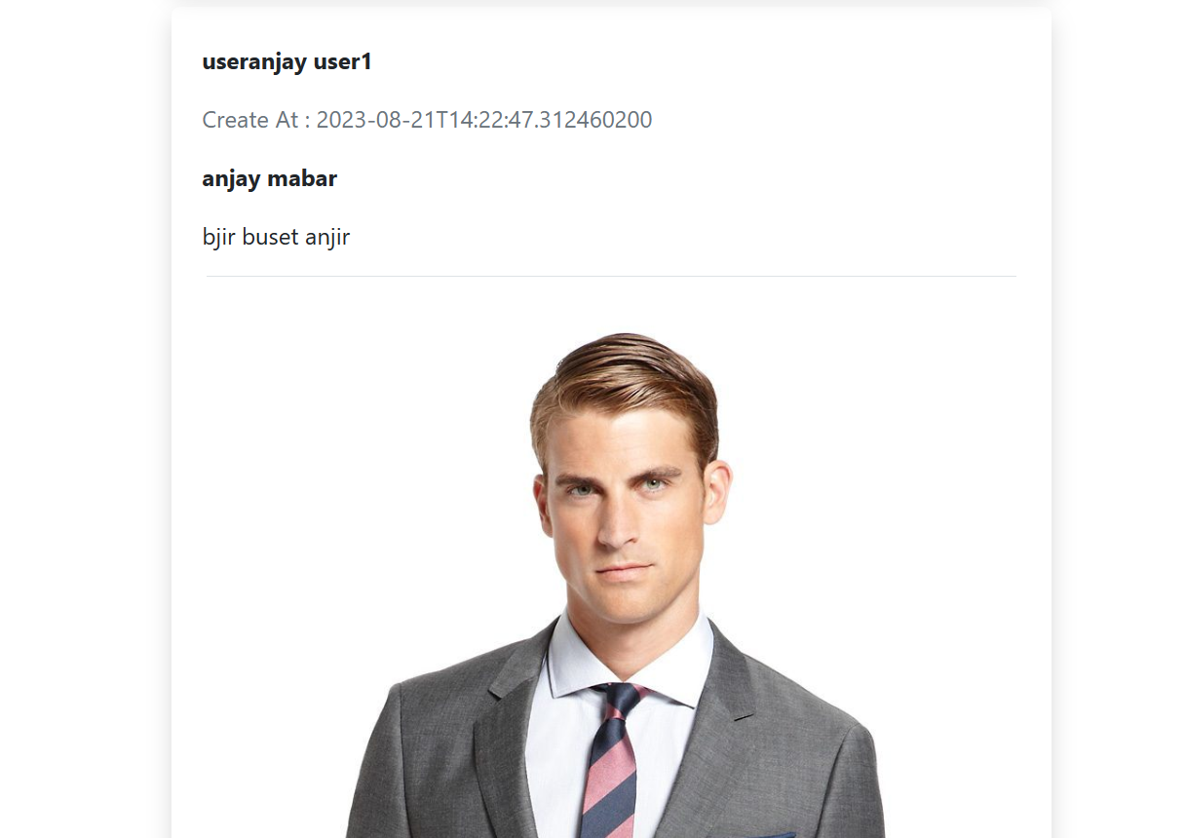
5. Test Results
Cross Browser Testing

Slide 16
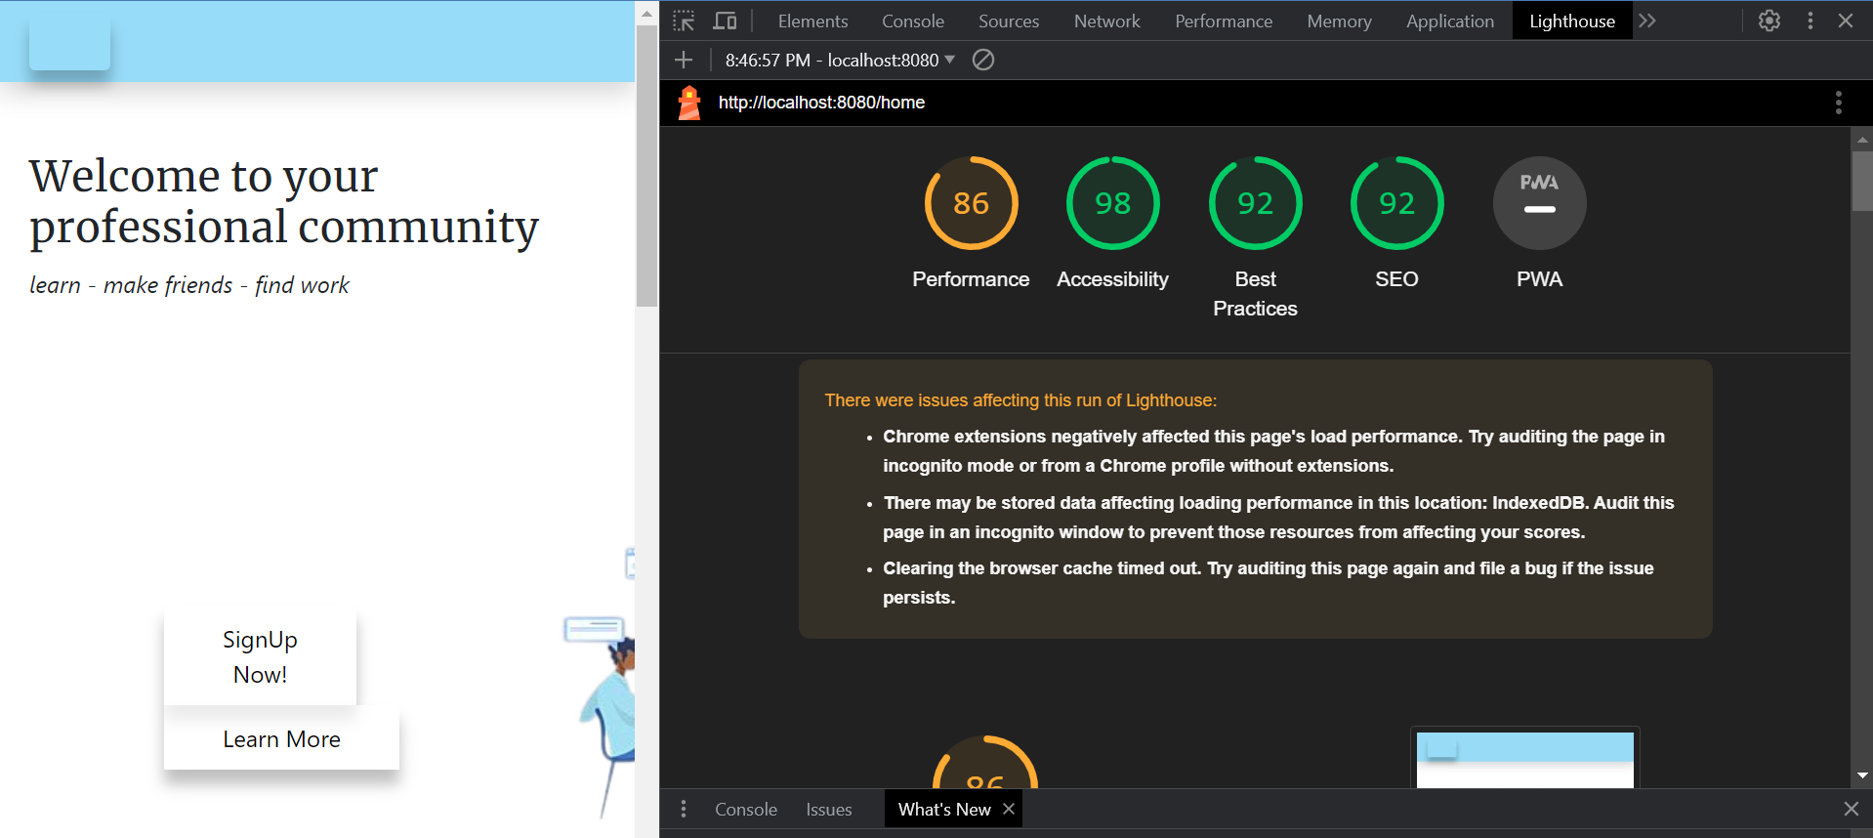
5. Test Results
Load Testing

Slide 17





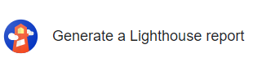
6. Testing Tools Tools
Testing Tools
JUNIT
InteliJ
Chrome Dev Tools
Lighthouse
Microsoft Edge
Mozila Firefox

Slide 18
7. Project Milestones & Tasks
Project Task ID | Project Task Description | Project Milestone ID
1 | Analyze and suggest choice of Test Methods | 1
2 | Schedule the Test Optimally | 1
3 | Develop the Phase Test Plan | 1
5 | Develop Test Cases & Scripts | 2
6 | Execute the Tests & Document the results | 3

Slide 19
8. Milestone Feedback & Action taken
Project Milestone ID | Milestone Feedback received from Tutor / Learning Facilitator | Action Taken (Yes / No)
1
2
3

Slide 20
9. Modifications Made based On Feedback

Slide 21
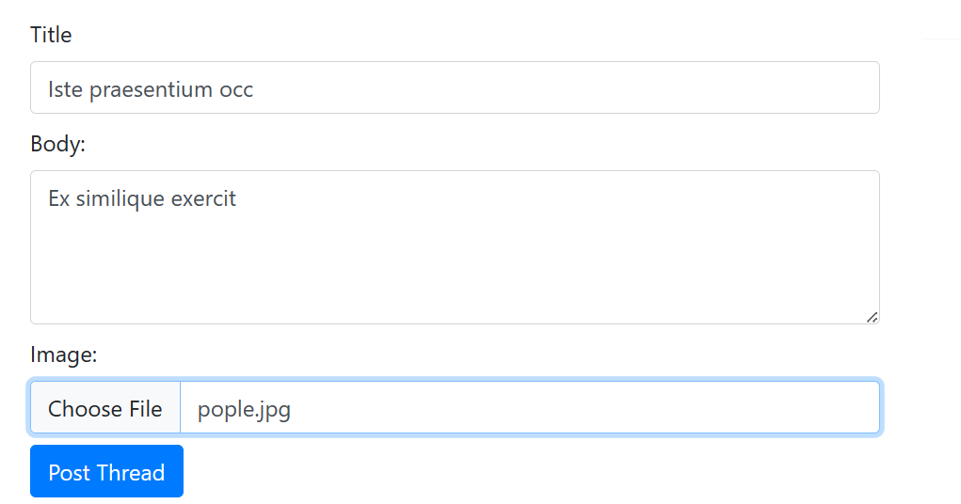
10. Project Results

Slide 22
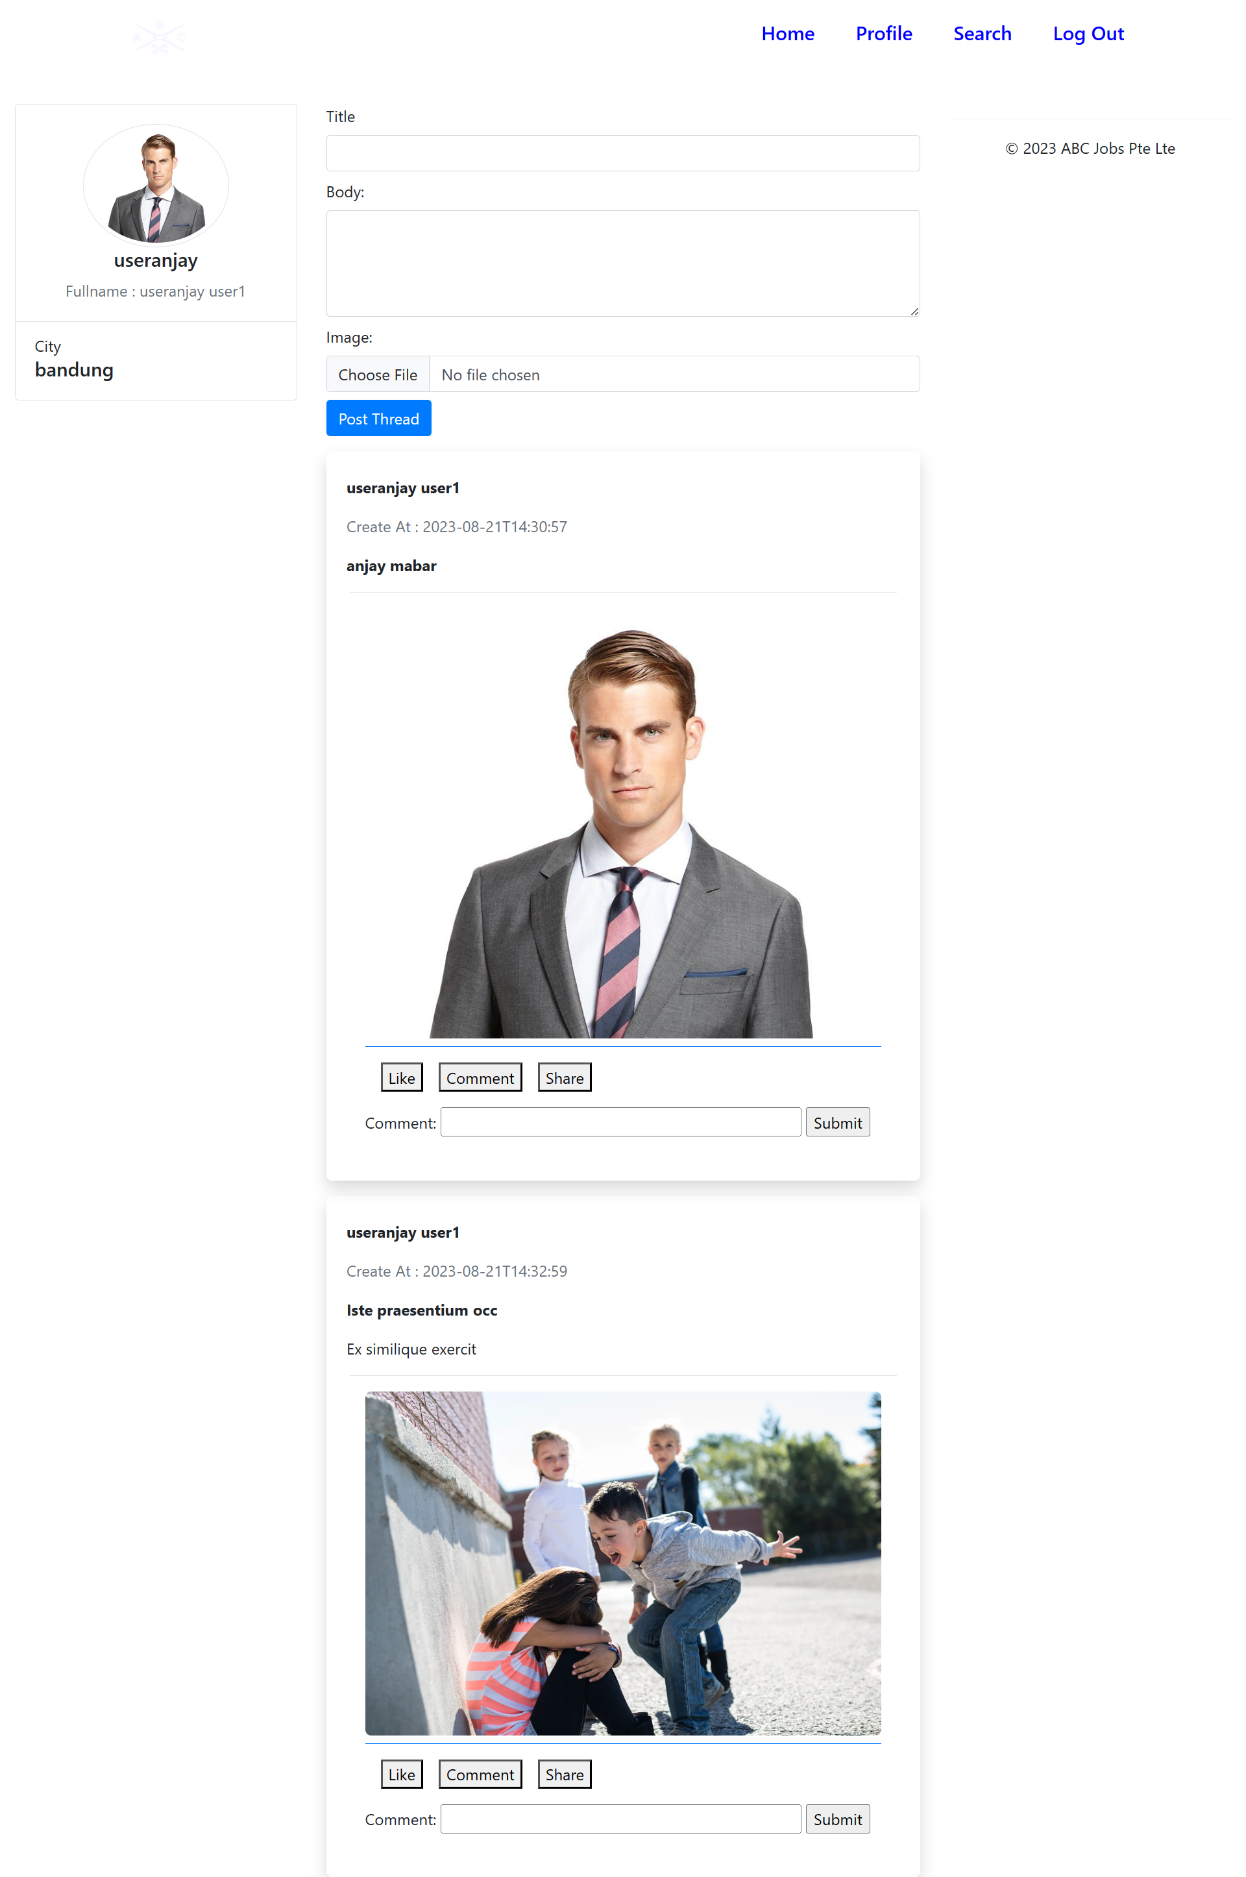
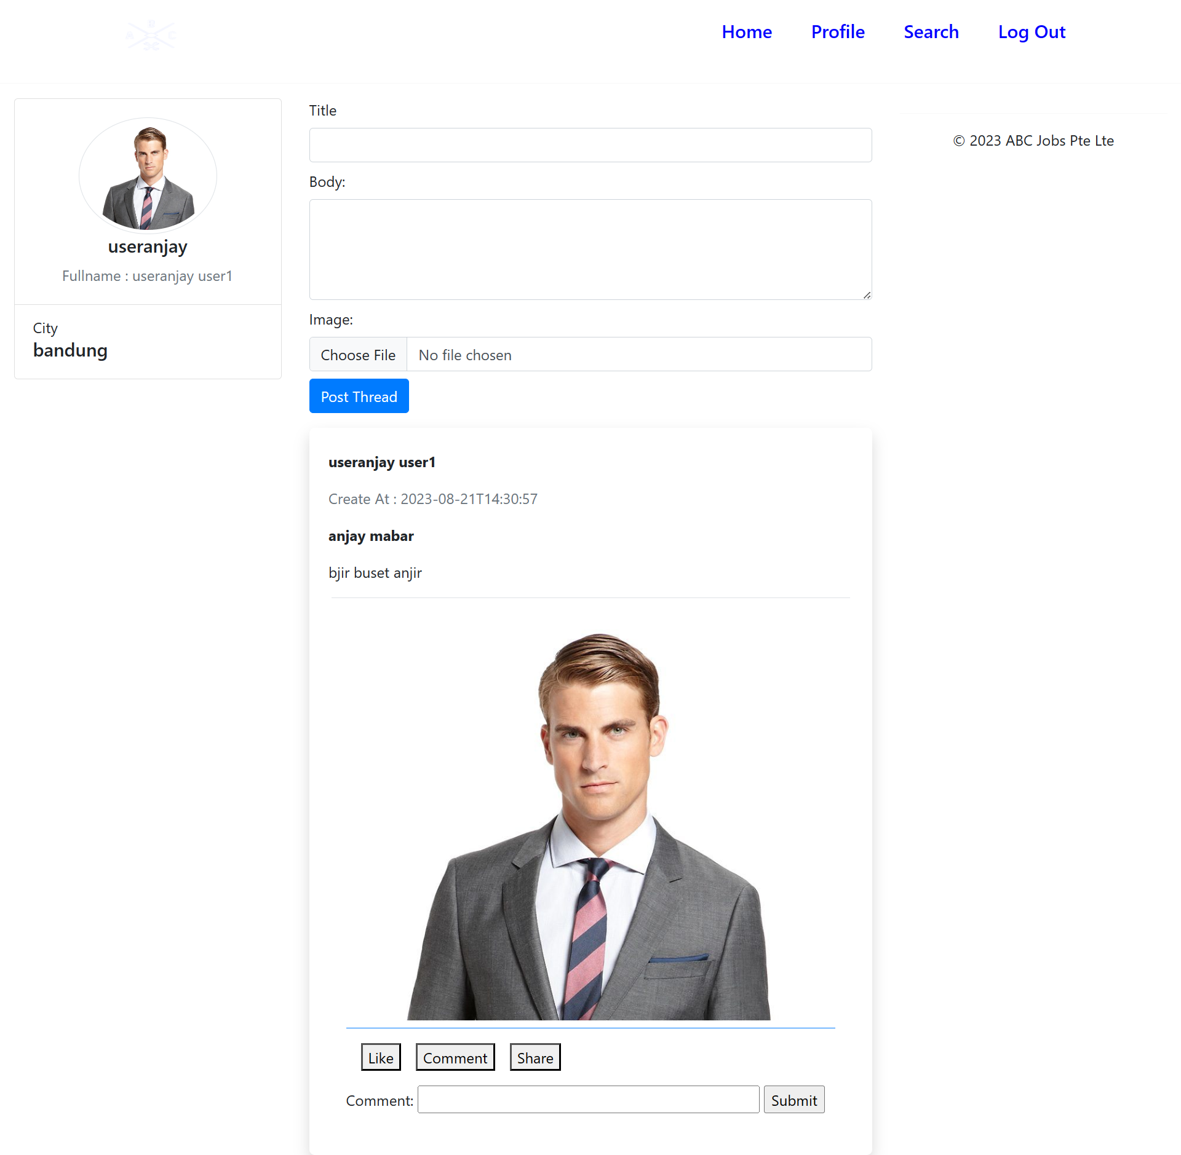
10. Project Results

Slide 23
11. Proposed Improvements
List of Improvements
Make a More interactive Interface
Refresh the Design
Make Posts and Apply Job similar on LinkedIn
Add Messages Features

